Slide 1
Knowledge Discovery Game
User Guide

Slide 2
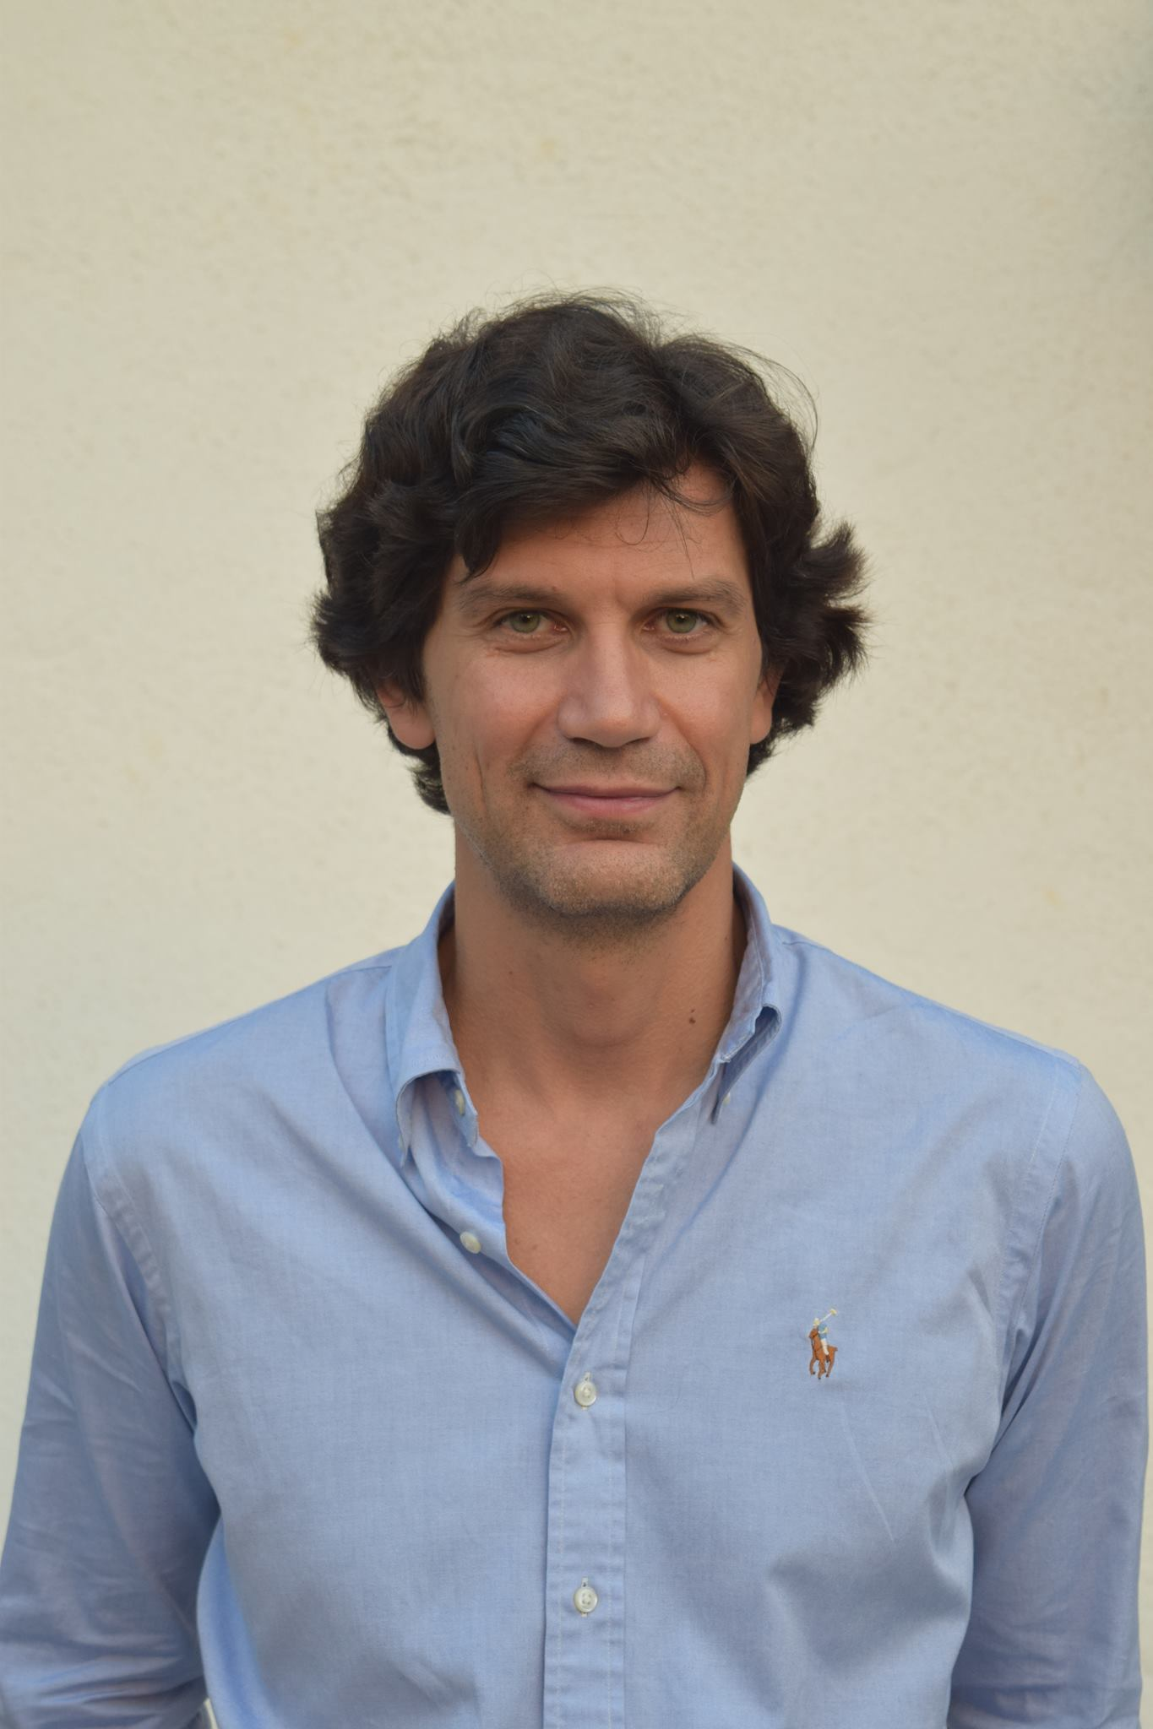
Dimitar Bakardzhiev is an expert in managing successful and cost-effective technology development. With his blend of technical, managerial and operational expertise, he effectively combines the theory and practice of Agile and Kanban Method to deliver business results.
As a Kanban trainer, coach, expert Kanban practitioner and Brickell Key Award 2015 Finalist, Dimitar puts lean principles to work every day when managing complex software projects.
Dimitar has published David Anderson’s Kanban book as well as books on Lean, Theory of Constraints by Goldratt and Deming's Theory of Management in the Bulgarian language.
@dimiterbak

Slide 3
Agenda
Play the Knowledge Discovery Game

Slide 4
Knowledge Discovery Game is licensed under a Creative Commons Attribution-ShareAlike 4.0 International License. Customisation is encouraged!

Slide 5
The goal of the Knowledge Discovery Game is to let people understand a knowledge discovery process.

Slide 6
Learning outcomes
People feel happy when the knowledge needed to e discovered is minimised.
A them is most productive then the average Knowledge Discovery Efficiency (KEDE) is maximised.
It is possible to measure if people felt happy and were productive.

Slide 7
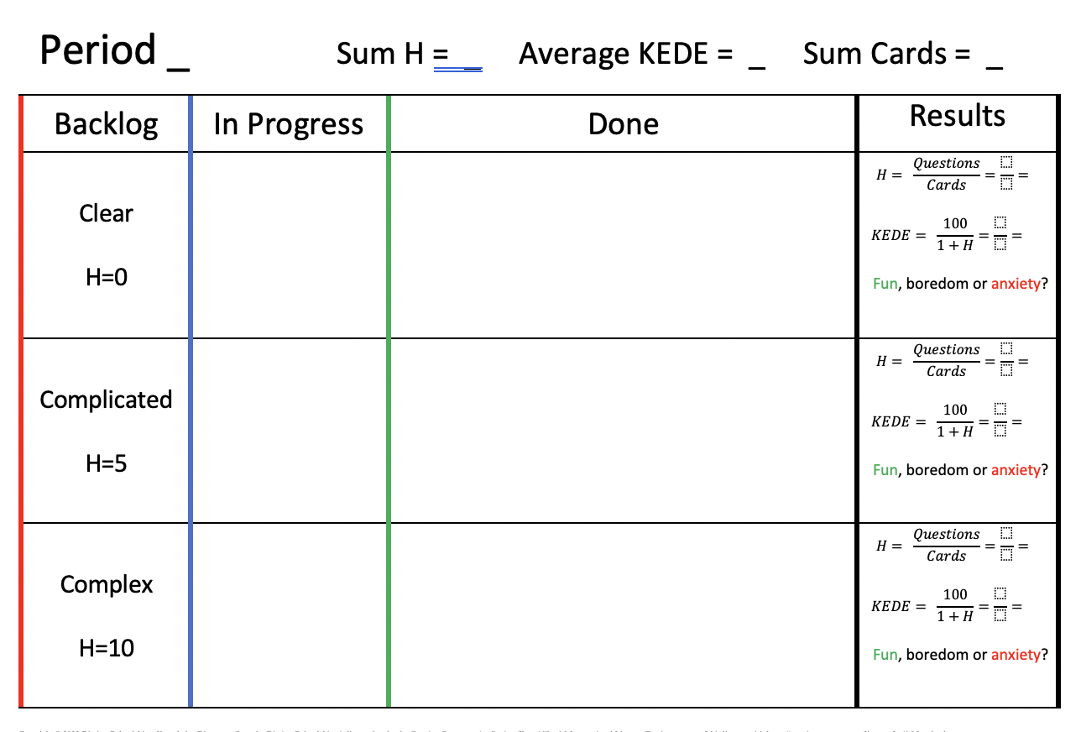

Slide 8


Slide 9
Roles
Team member. Starts, moves and completes work items.
Novice, existing knowledge H=1
Competent, existing knowledge H=4
Expert, existing knowledge H=9

Slide 10
Setup (for each period)
Get into teams of 3 people.
Each team member to pick a role.
Generate a backlog of:
10 clear features
10 complicated features
10 complex features
Leave the cards in their section of “Backlog” column.
Assign who will be working on what type of feature.

Slide 11
Rules
You as a team have 10 days to finish 30 cards. Each day begins with a “daily meeting”. In your “daily meeting” each of the team members should follow the rules:
Do you have a card In Progress?
If Yes then
Acquire missing information from Google
Cross the dots per the information you just acquired
If No then
Start a new card,
Check if you have the knowledge needed (existing + discovered)?
If Yes then
move the in Progress card into Done column
If No then
Leave the card in Progress

Slide 12
Daily routine
Do you have
a card in
Progress?
New day
Do you
have the
Knowledge?
No
Yes
Google It
Cross
the dots
Move
the card to
Done
Yes
Leave
the card in
Progress
No
Start
new card
End of
Day

Slide 13
After the game
Write into Done the number of cards delivered
Calculate Sum H, Average KEDE and Sum Cards
Answer how you felt while doing the activity by marking one of:
Fun,
boredom or
anxiety?

Slide 14
Debrief
In your teams, list and prepare to report back:
Concepts, practices, and outcomes simulated in the game
Your observations
Workplace parallels

Slide 15
Period 1
Existing knowledge |  | Missing information
Novice | 1 | Complex | 10
Competent | 4 | Complicated | 5
Expert | 9 | Clear | 0

Slide 16
Period 2
Existing knowledge |  | Missing information
Novice | 1 | Clear | 0
Competent | 4 | Complicated | 5
Expert | 9 | Complex | 10

Slide 17
Period 3
Existing knowledge |  | Missing information
Novice | 1 | Clear | 0
Competent | 4 | Complex | 10
Expert | 9 | Complicated | 5

Slide 18
Period 4
Existing knowledge |  | Missing information
Novice | 1 | Complicated | 5
Competent | 4 | Complex | 10
Expert | 9 | Clear | 0

Slide 19
Discussion
Simulation results

Slide 20
“System is not a sum of the behavior of its parts, it’s the product of their interactions.”
Russell L. Ackoff (1994)
https://www.youtube.com/watch?v=OqEeIG8aPPk
An event hosted by Clare Crawford-Mason and Lloyd Dobyns
to capture the Learning and Legacy of Dr. W. Edwards Deming.
Notes:
https://www.youtube.com/watch?v=OqEeIG8aPPk

Slide 21
“The goal is to make full use of the workers’ capabilities by building up a system that will allow the workers to display their full capabilities by themselves.”
Y. SUGIMORI, K. KUSUNOKI, F. CHO & S. UCHIKAWA (1977)
Toyota production system and Kanban system

Slide 22
List your conclusions
Work

